Slide 1

Flexbox
01
02
CSS Layout
03

Slide 2
Content
01
Flexbox
02
Container
03
Children

Slide 3
01
Flexbox
What is Flexbox?

Slide 4
What is Flexbox?
One-dimensional layout method for arranging items in rows or columns.
Items flex (expand) to fill additional space or shrink to fit into smaller spaces..
https://developer.mozilla.org/en-US/docs/Learn/CSS/CSS_layout/Flexbox

Slide 5
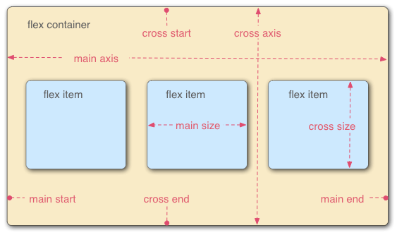
The Flex Model
When elements are laid out as flex items, they are laid out along two axes.

Slide 6
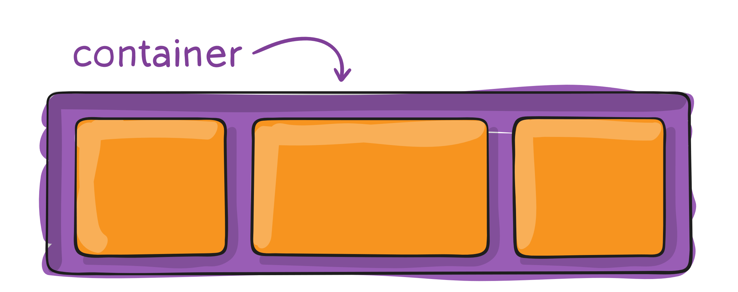
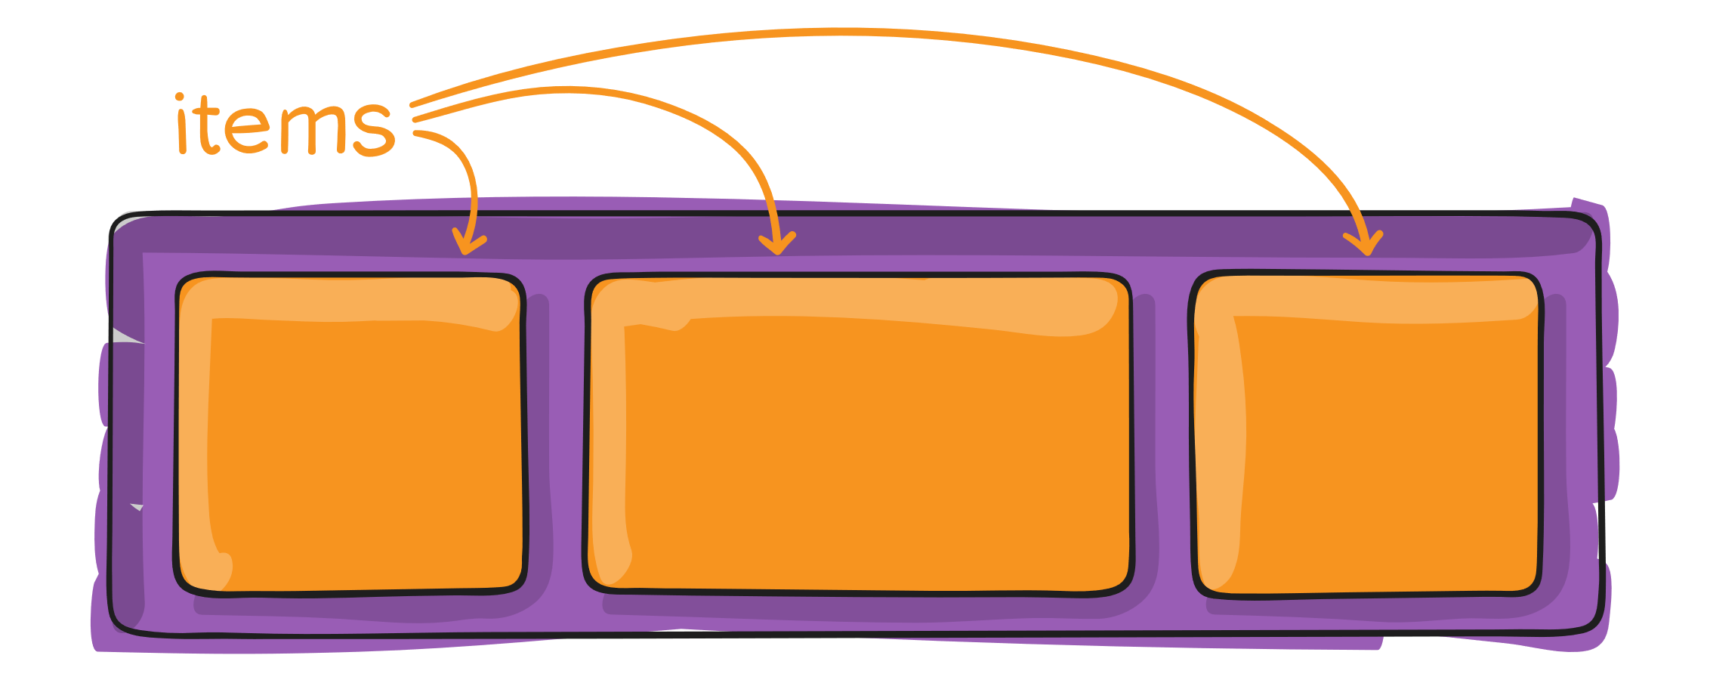
Flexbox properties
You can`t remember or learn every property!
Try understanding the concepts and what you can do with flex and then check the reference.
https://css-tricks.com/snippets/css/a-guide-to-flexbox/

Slide 7
02
Container
Flex Container Properties

Slide 8
display: flex;
Set a value of 'flex' to the display property on the parent element of the elements you want to affect.
.container {
display: flex;
}

Slide 9
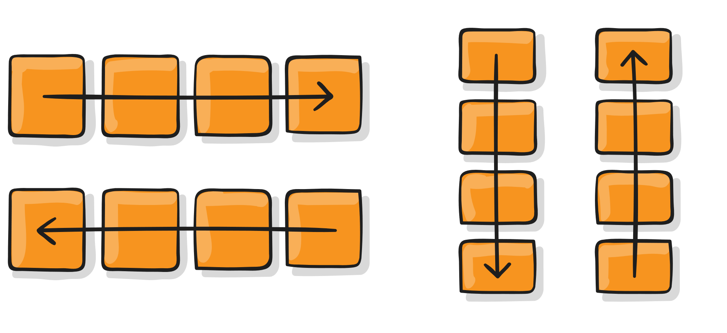
flex-direction
row | row-reverse | column | column-reverse
Specifies which direction the main axis runs (which direction the flexbox children are laid out in). By default, is row.
.container {
flex-direction: row;
}

Slide 10
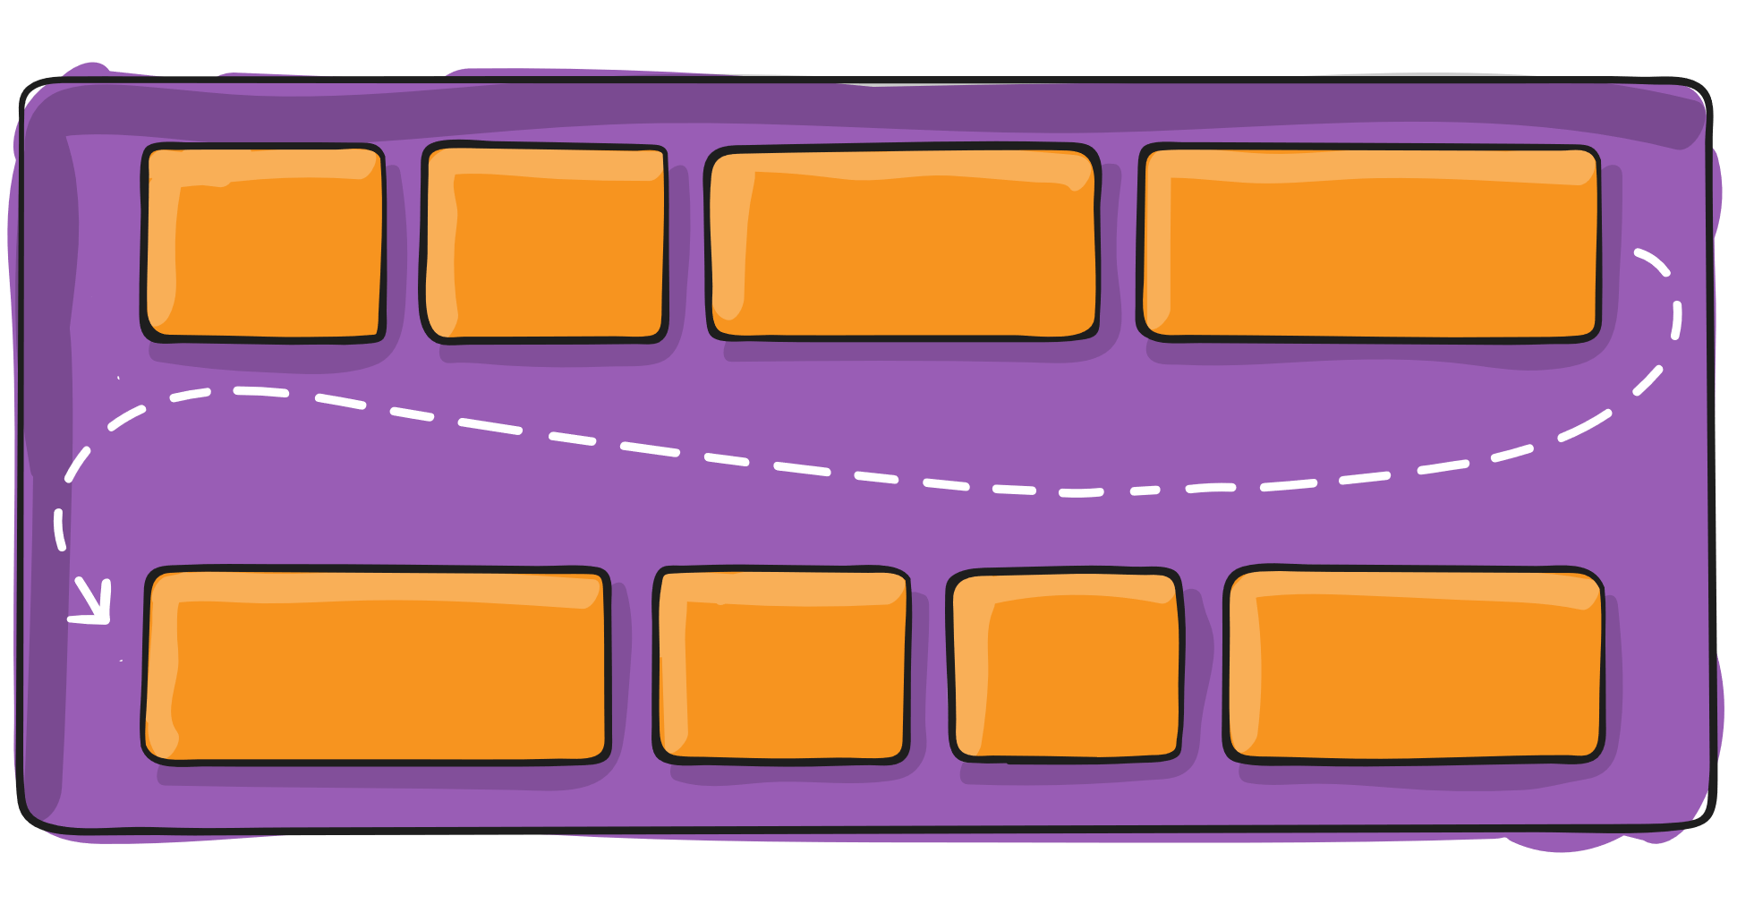
flex-wrap
nowrap | wrap | wrap-reverse
By default, flex items will all try to fit onto one line. Allow the items to wrap as needed with this property
.container {
flex-wrap: wrap;
}

Slide 11
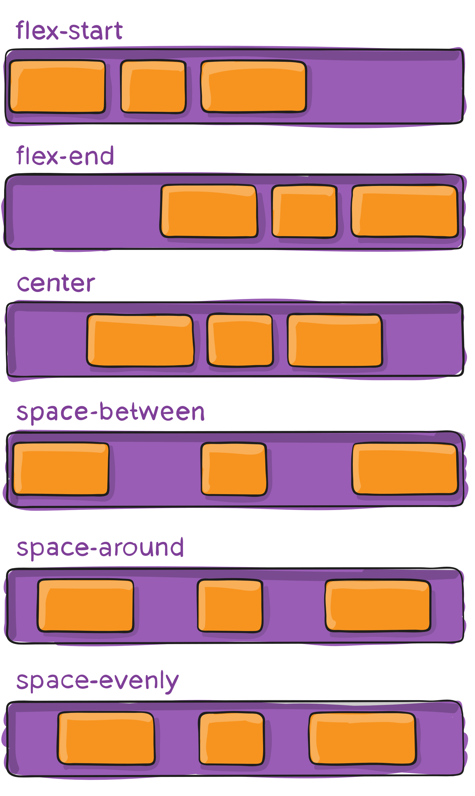
justify-content
flex-start | flex-end | center | space-between | space-around | space-evenly | start | end | left | right
.container {
justify-content: center;
}

Slide 12
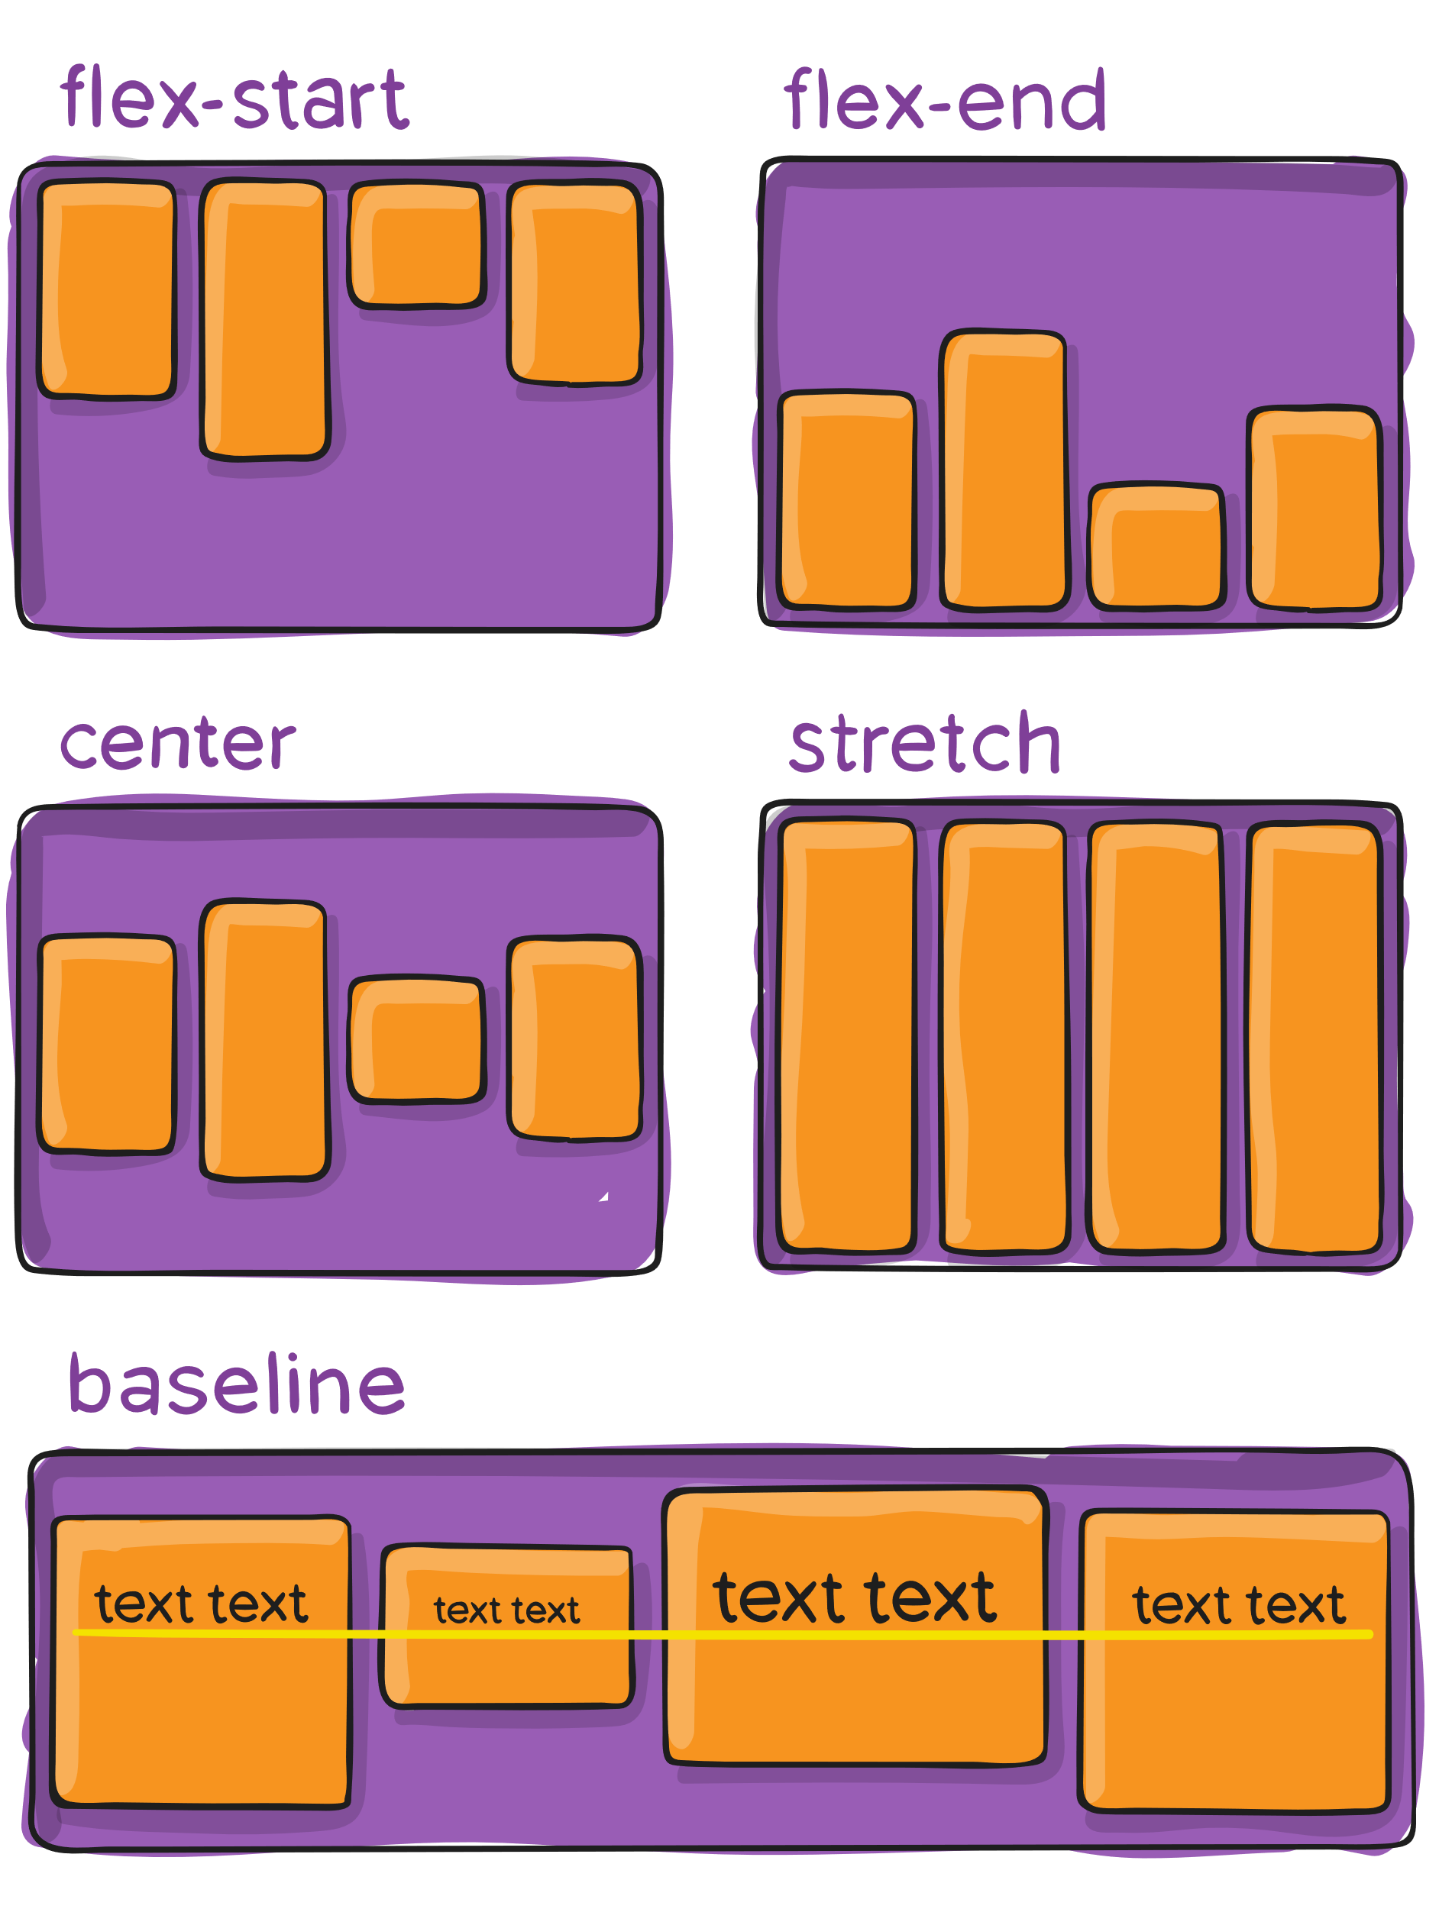
align-items
stretch | flex-start | flex-end | center | baseline | first baseline | last baseline | start | end | self-start | self-end

Slide 13
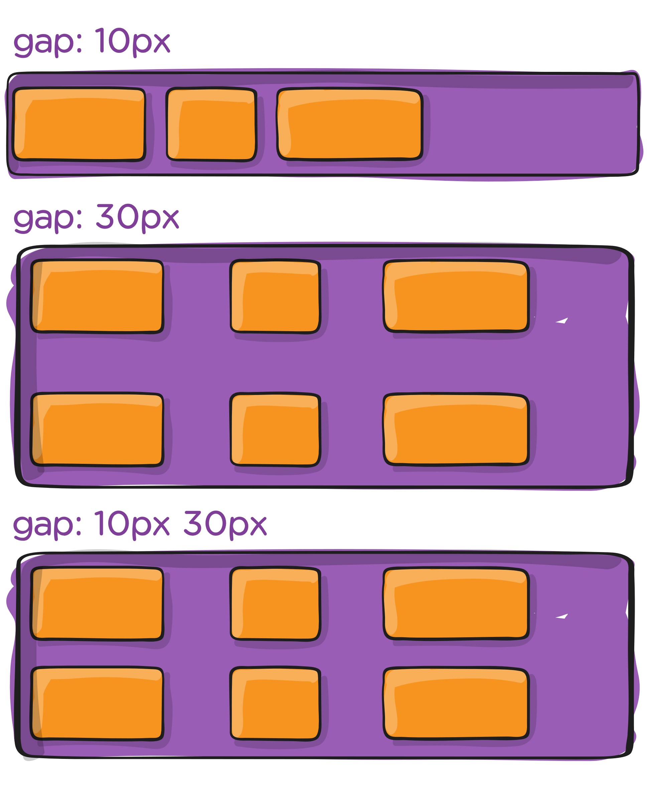
gap, row-gap, column-gap
Controls the space between flex items. It applies that spacing only between items not on the edges.
.container {
gap: 10px;
gap: 10px 20px;
row-gap: 10px;
column-gap: 20px;
}

Slide 14
03
Items
Flex Items Properties

Slide 15
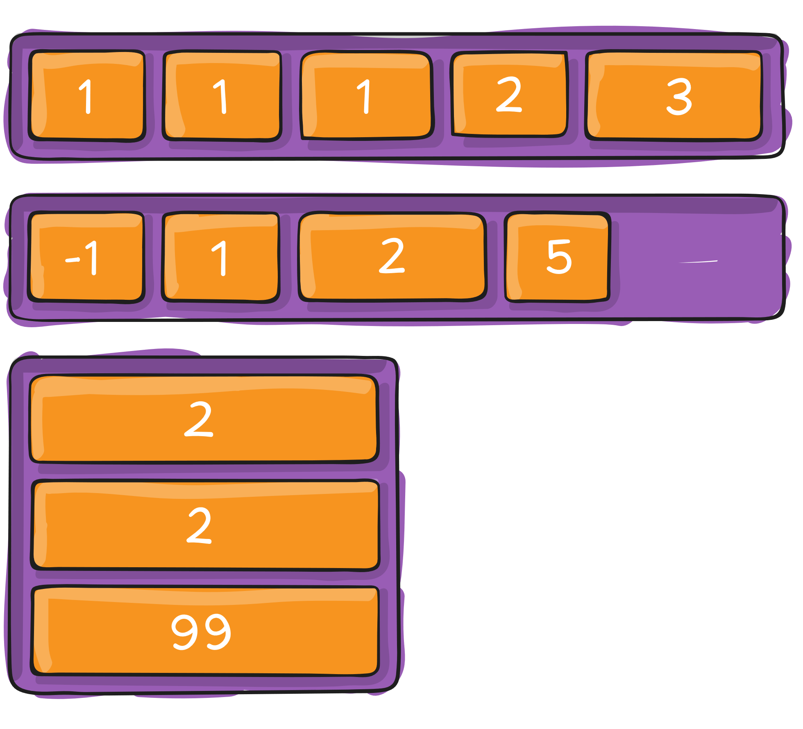
order
By default, flex items are laid out in the source order.
The order property controls the order in which they appear in the flex container.
.item {
order: 5
}

Slide 16
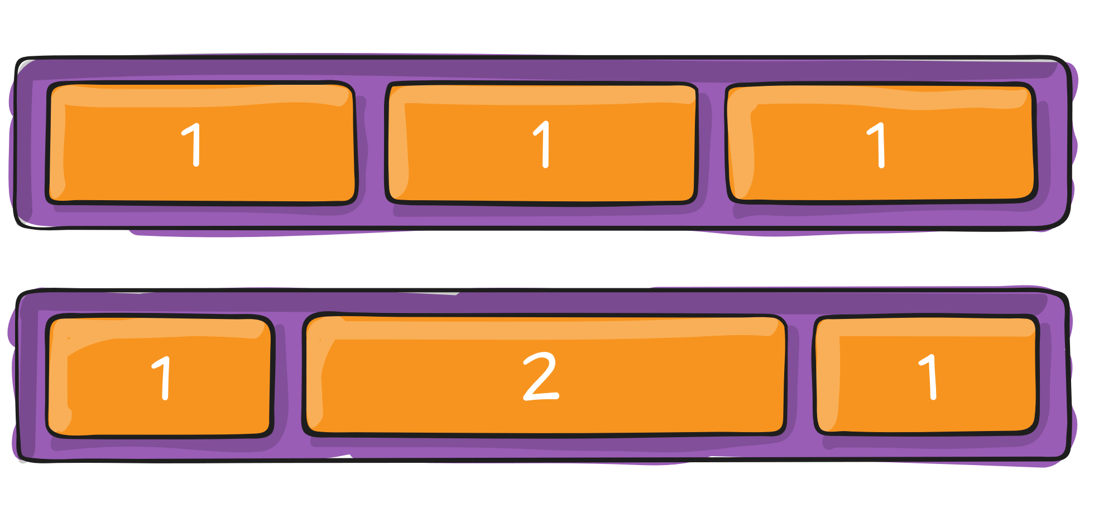
flex-grow | flex-shrink
flex-grow defines the ability for a flex item to grow if necessary.
flex-shrink defines the ability for a flex item to shrink if necessary.
.item {
flex-grow: 2;
}

Slide 17
flex-grow
Sets the flex grow factor, which specifies how much of the flex container's remaining space should be assigned to the flex item's main size.
.item {
flex-grow: 2;
}

Slide 18
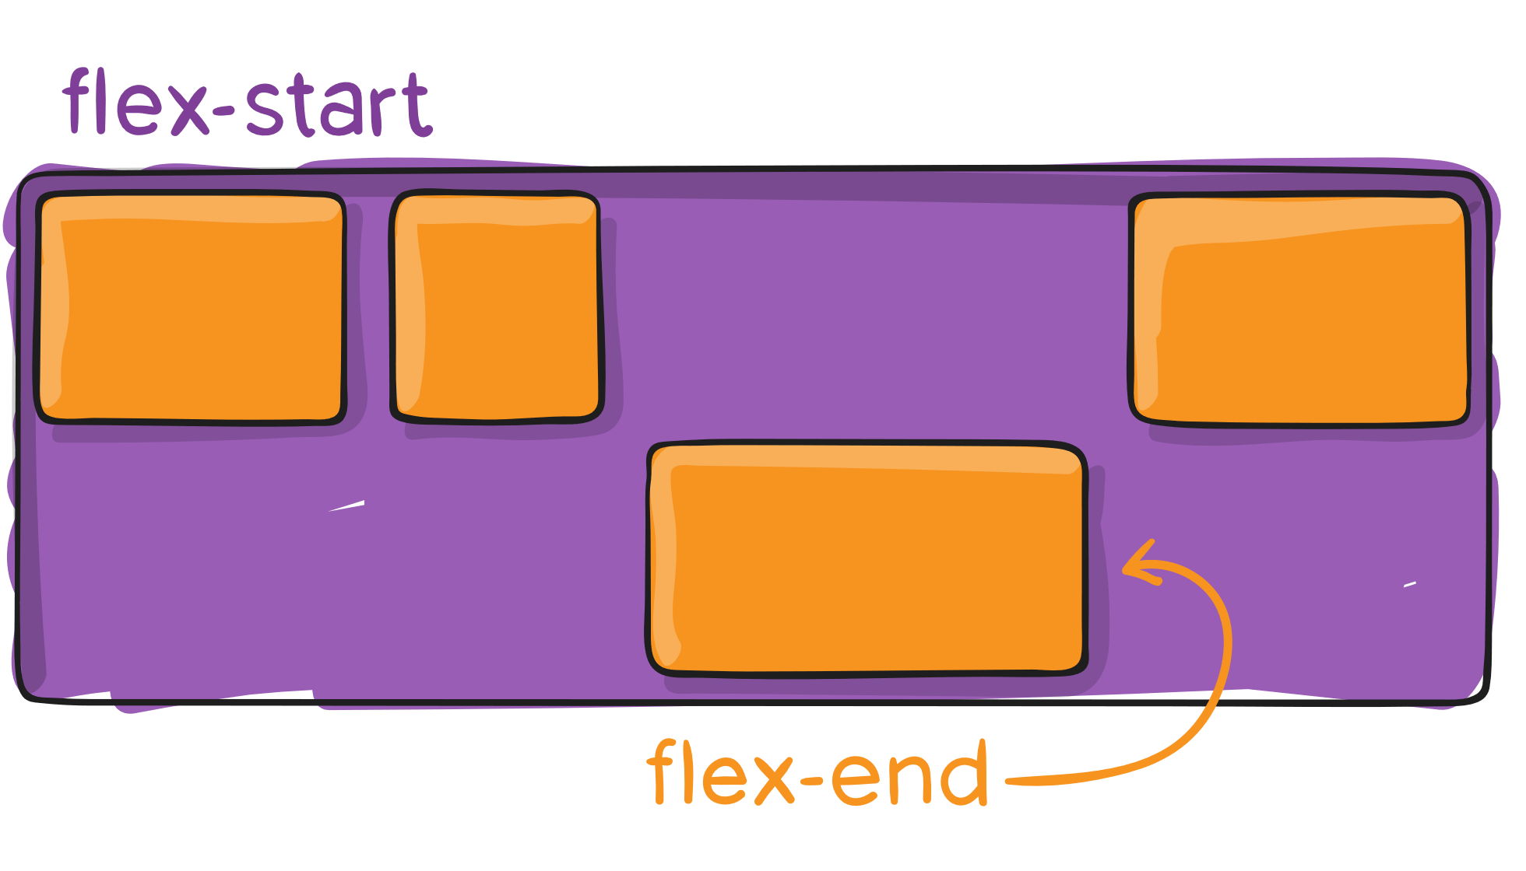
align-self
auto | flex-start | flex-end | center | baseline | stretch;
This allows the default alignment (or the one specified by align-items) to be overridden for individual flex items.
.item {
align-self: auto;
}

Slide 19
Exercises
https://flexboxfroggy.com/
https://css-tricks.com/snippets/css/a-guide-to-flexbox/
http://www.flexboxdefense.com/
https://codingfantasy.com/games/flexboxadventure

